Slide 1



EASTERN MEDITERRANEAN UNIVERSITY
ENGLISH PREPARATORY SCHOOL
ORIENTATION FOR EPS STUDENTS

Slide 2

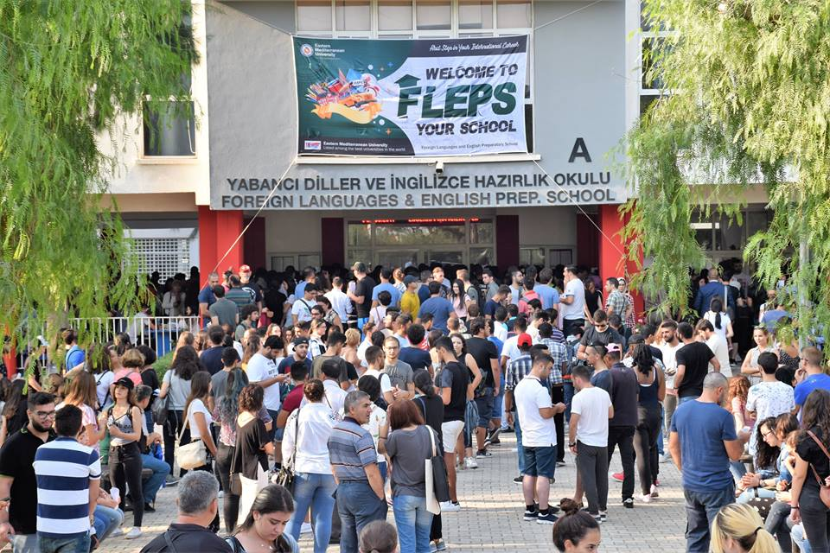


Welcome to FLEPS, your school

Slide 3
Who is who in this institution
The Director of FLEPS:
  Asst. Prof. Dr. Mutlu KALE
The Assistant Director of Student and Administrative Affairs:
  Senior Instructor Filiz KAVAZ

Slide 4
Who ıs who ın this ınsıtutıon
The Assistant Director of Testing Unit:
  Instructor Müsteyde Akhisar
The Assistant Director of Syllabus Unit
  Senior Instructor Celen Muezzın

Slide 5
HOW CAN I GET INFORMATION
STUDENT AFFAIRS TEAM (SAT)
Office no:224, 2nd Floor
Phone no:0392 630 1112
Contact: https://fleps.emu.edu.tr

Slide 6
HOW CAN I GET INFORMATION
SAT COORDINATOR : Heves SORGUÇ
RESEARCH ASSISTANTS:
Neepa NAROTTAM LODHIA
Aslıgül ASKIN

Slide 7
ASSISTANTS:
SELAY KESEN
YASEMİN YILŞEN ÖZALP
SONAY ASYA KAVAZ
ASAL SOLTANI CHAKINI

Slide 8
HOW CAN I GET INFORMATION
Student Affairs Secretary
Office no: 223, 2nd Floor
Phone no: 0392 630 2153
Pembe KARA
FLEPS Secretary
(office 212, 2nd Floor)
Phone no: 0392 630 1330
Emine CANNUR
Administrator
Office no: 210, 2nd Floor
Phone no: 0392 630 2188
Ercan ERCANLAR
Computer Operator
Office no: 1E, 1st Floor
Phone no: 0392 630 2346
Whatsapp No:05338711075
Seyyed Ali Kamalı MOHAMAREH

Slide 9
EXTRA CURRICULAR ACTIVITIES (ECA)
TEAM LEADER: Zekiye DELLALOĞLU
TEAM MEMBERS: Sultan TAŞKIRAN
Aysha LAMA
Munise KEŞANLI
Ayşe ÖZVERİR
Refika İLKAN
Fayka GURESUN

Slide 10


Some Activities for This Semester
SPEAKING CLUB
ACADEMIC SUPPORT

Slide 11
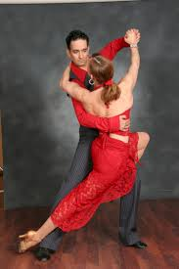
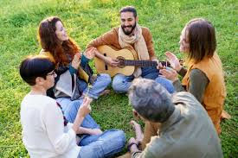
Salsa/ Bachata Dance Lessons
Grab Your Instrument

Slide 12
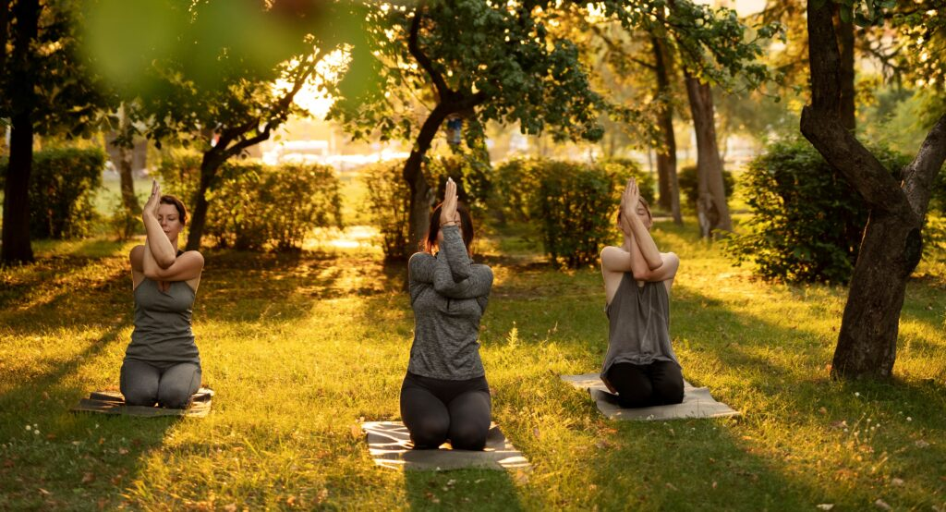

Nature Yoga
Upcycling

Slide 13
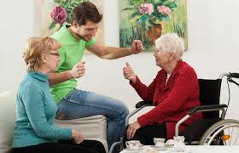
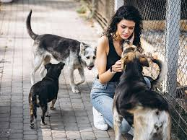
Elderly Home and Anımal Shelter Visit

Slide 14
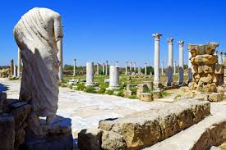
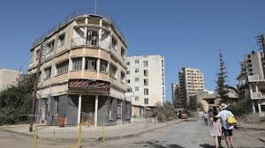
TRIPS
To Salamis Ruins
To Kapalı Maraş

Slide 15
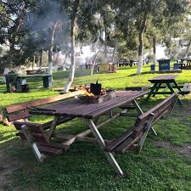
PICNIC

Slide 16


COMPETITIONS
QUIZ MONSTER
GRADED READER

Slide 17

DEBATE For EPSA010/11 and EPSU010
(MUN)

Slide 18
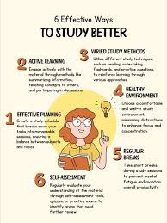

SEMINARS
Effective ways of Studying
Exam Anxiety

Slide 19
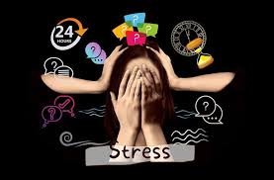

Methods of Coping With Stress
Psychological Health

Slide 20
ECA Member Responsible for the Promotion and Social Media Unit
Aysha LAMA
Students can share their pictures online through the school instagram account
( emu_fleps_official )

Slide 21
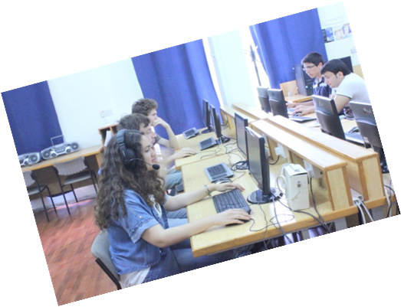
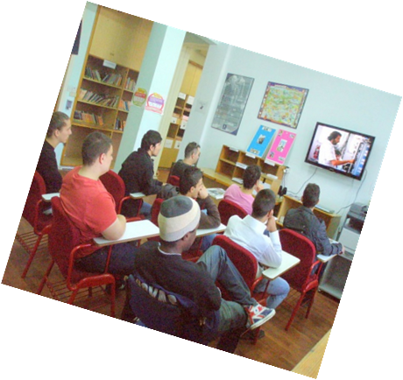
STUDENT SELF STUDY CENTER (sssc)

Slide 22
What is the SSSC? How will it help me?
The SSSC is for YOU and will help you:
Improve and develop your English!
Introduce you to a WIDE range of resources
Help you learn better
Develop exam techniques
Practice what you have learnt in class- alone or with your friends & teachers
Offer you a comfortable environment when studying
Play chess with your friends.

Slide 23
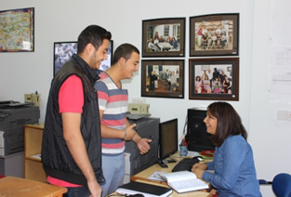
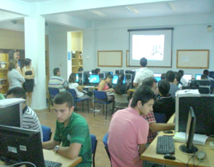
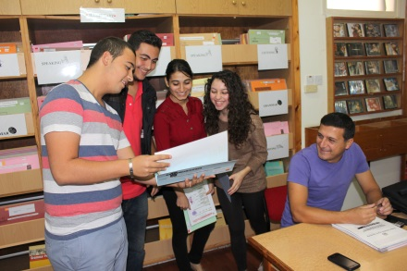
Our SSSC Areas
There are 3 different areas of the Study Center:
The Consultancy Area
The Multimedia (Computer) Area
3. The Self-Study Area

Slide 24
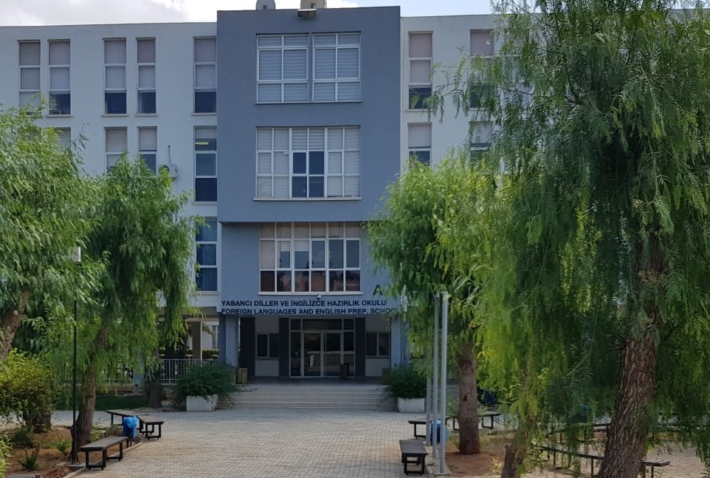
Did you know that Foreign Languages and English Preparatory School (FLEPS) is internationally accredited for quality education by Pearson Assured and EAQUALS?

Slide 25

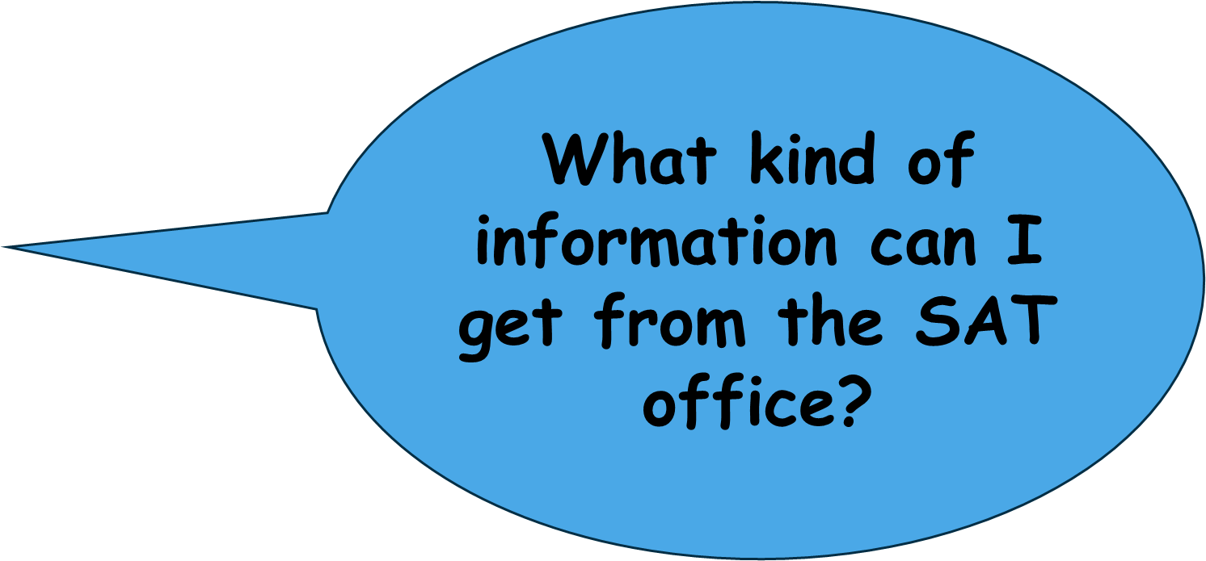

Slide 26
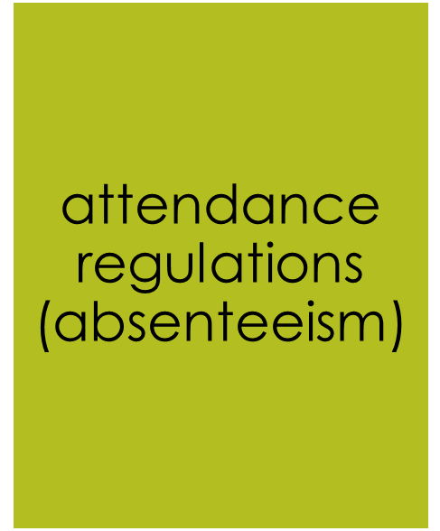

You can ask any questions about EPS.
For example;

Slide 27



Slide 28
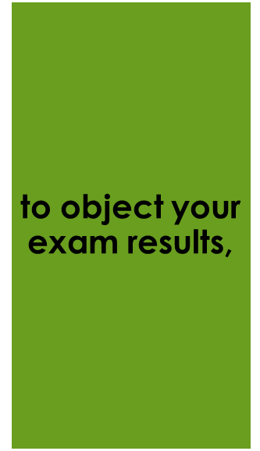





You can send a petition for any reasons on our website (https://fleps.emu.edu.tr/en).
For example;

Slide 29
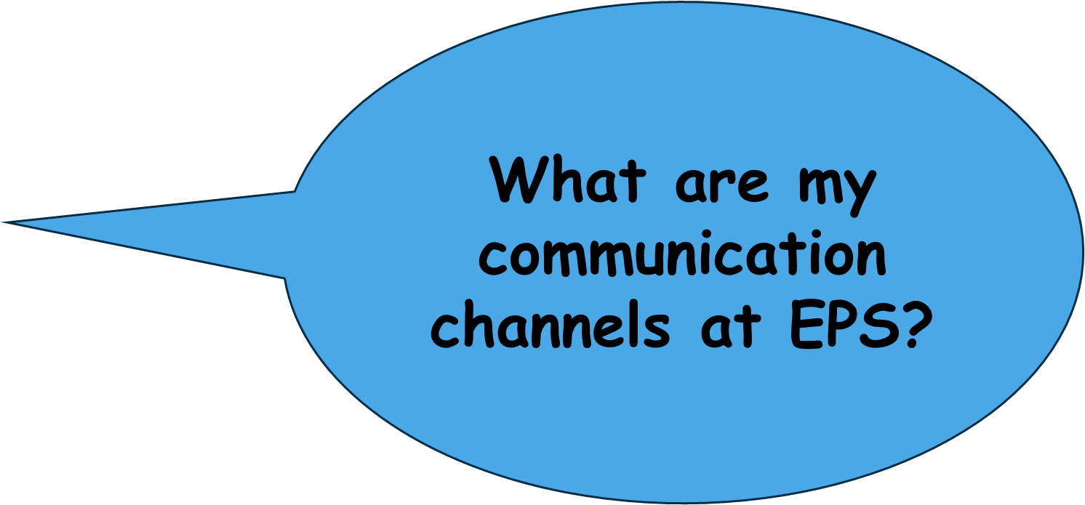

Slide 30
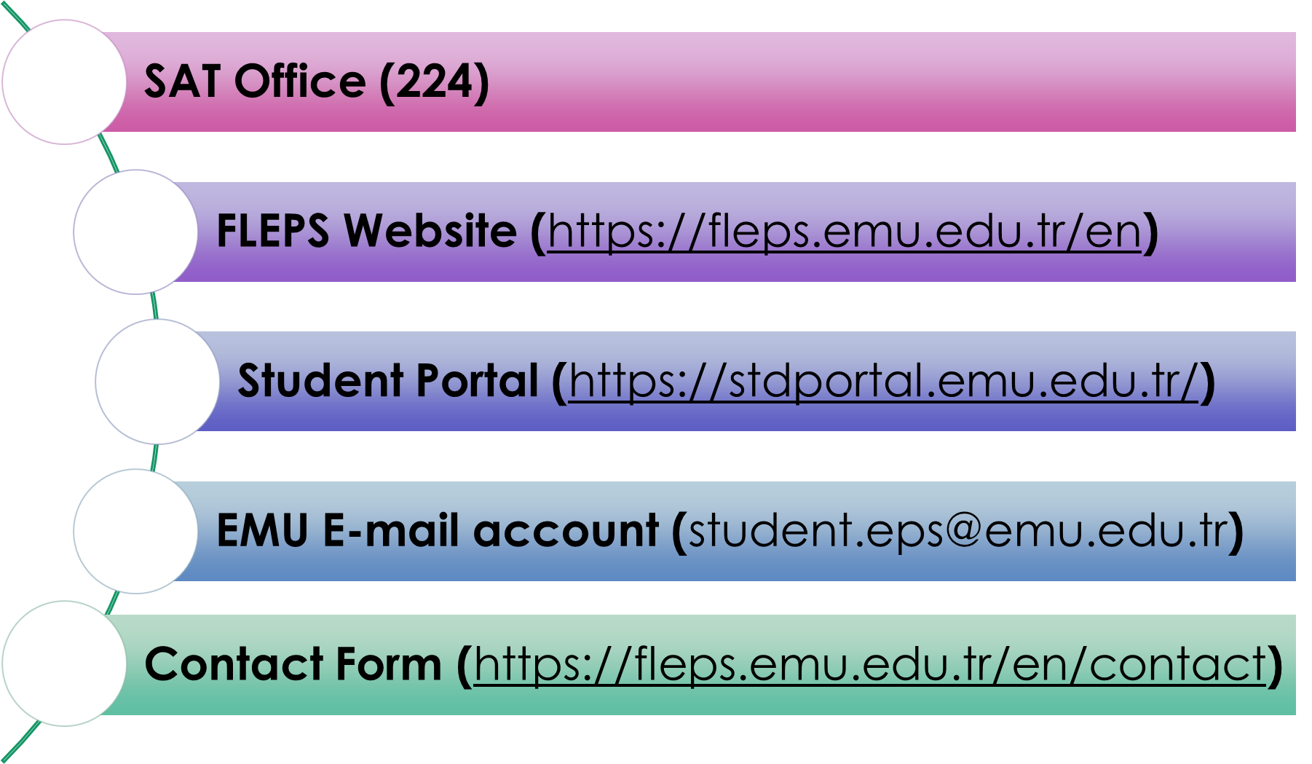

Slide 31

FLEPS WEBSITE

Slide 32

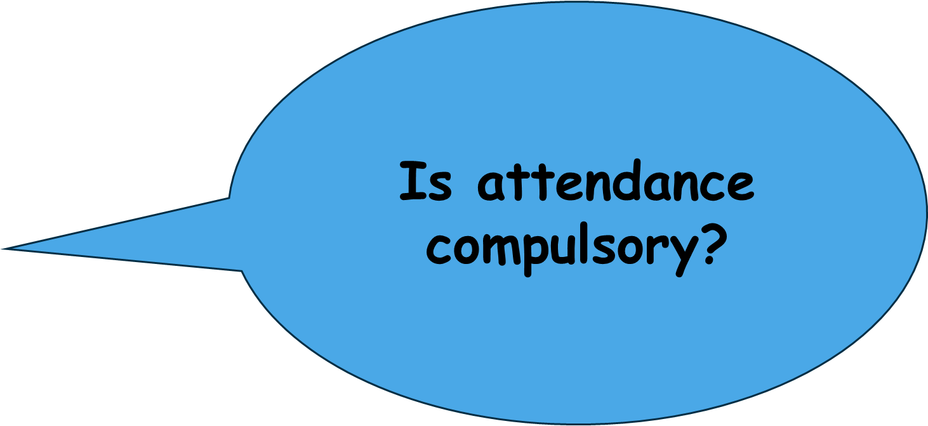

Slide 33
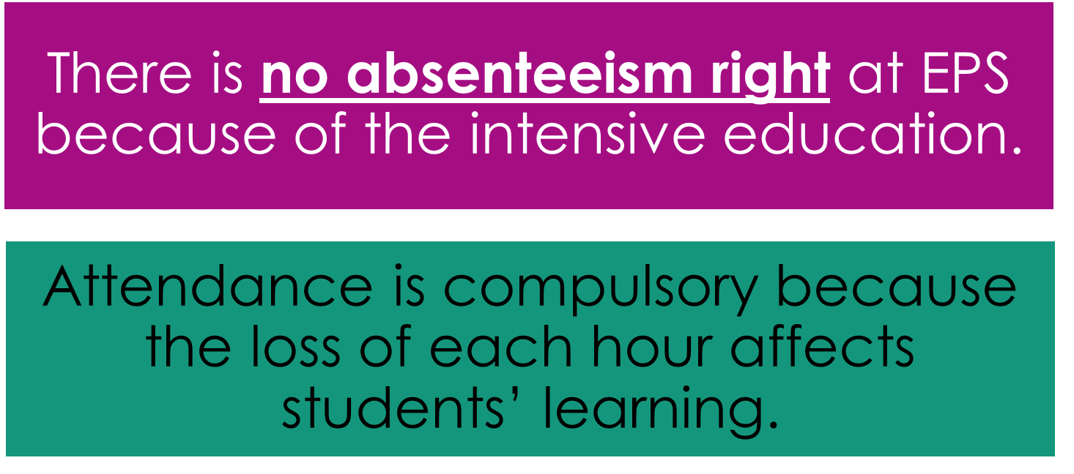
ATTENDANCE LIMIT IS 60 THIS SEMESTER

Slide 34
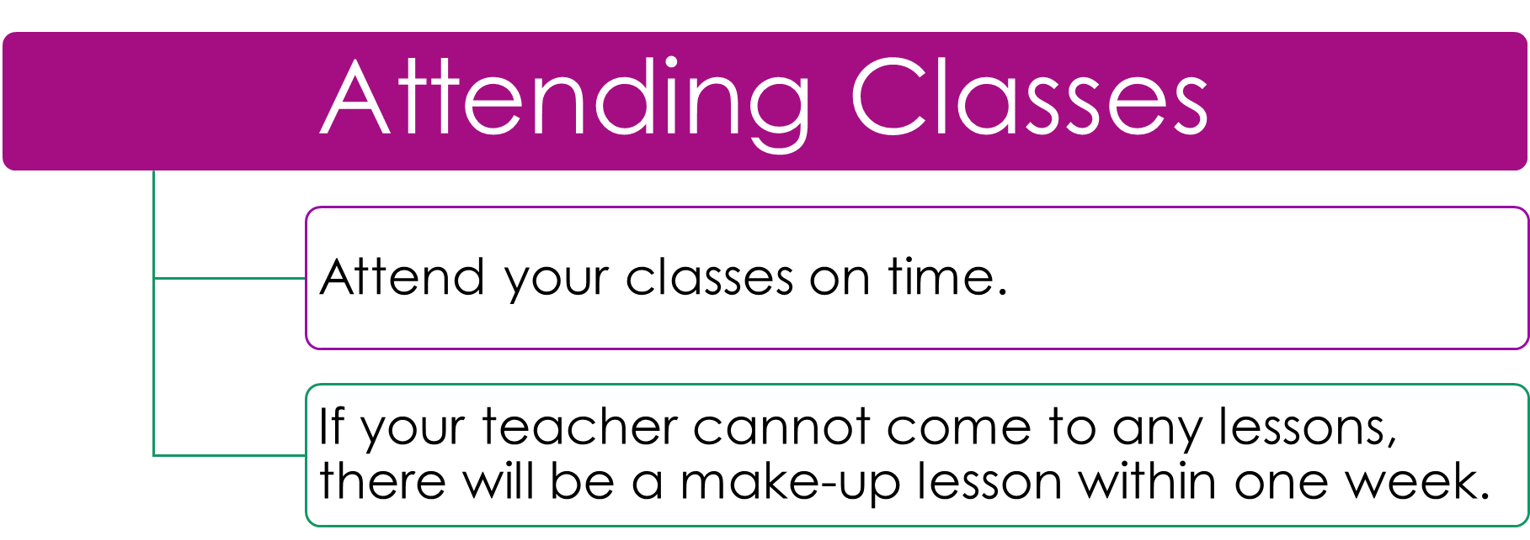

Slide 35
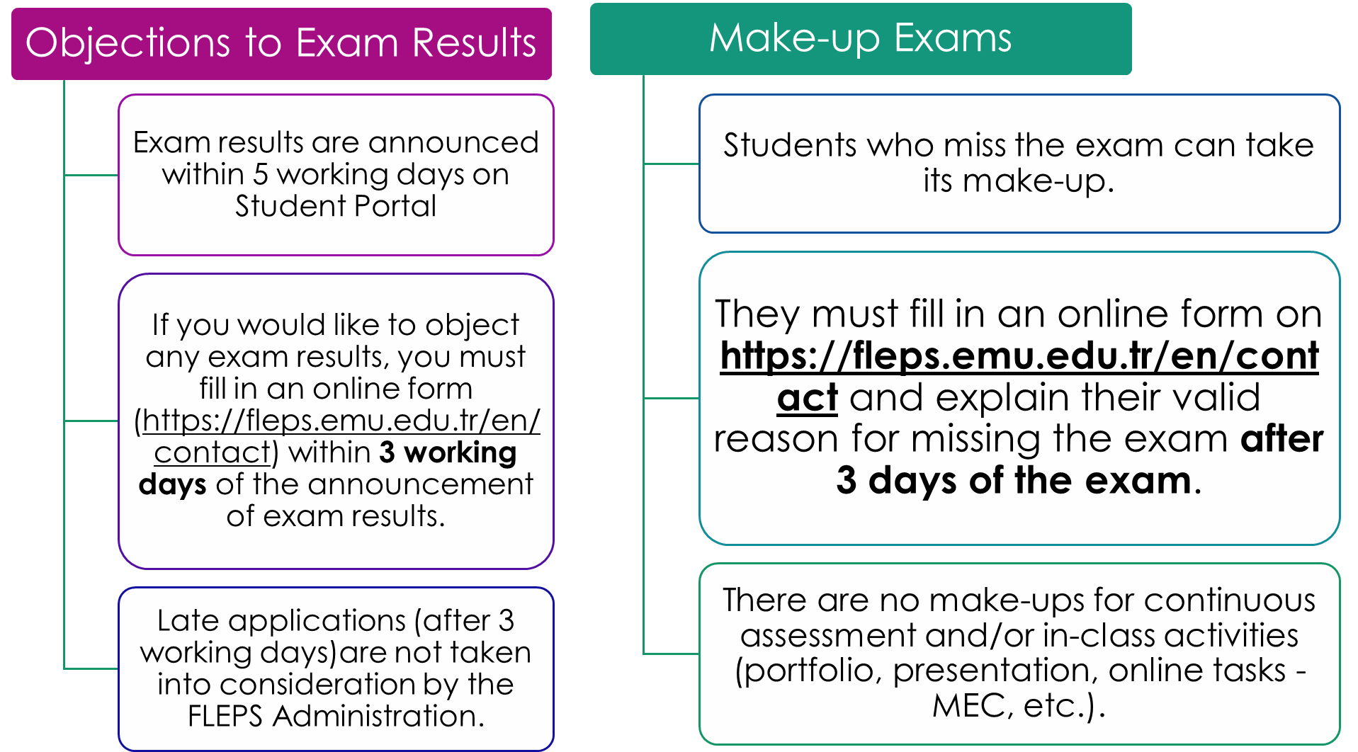

Slide 36
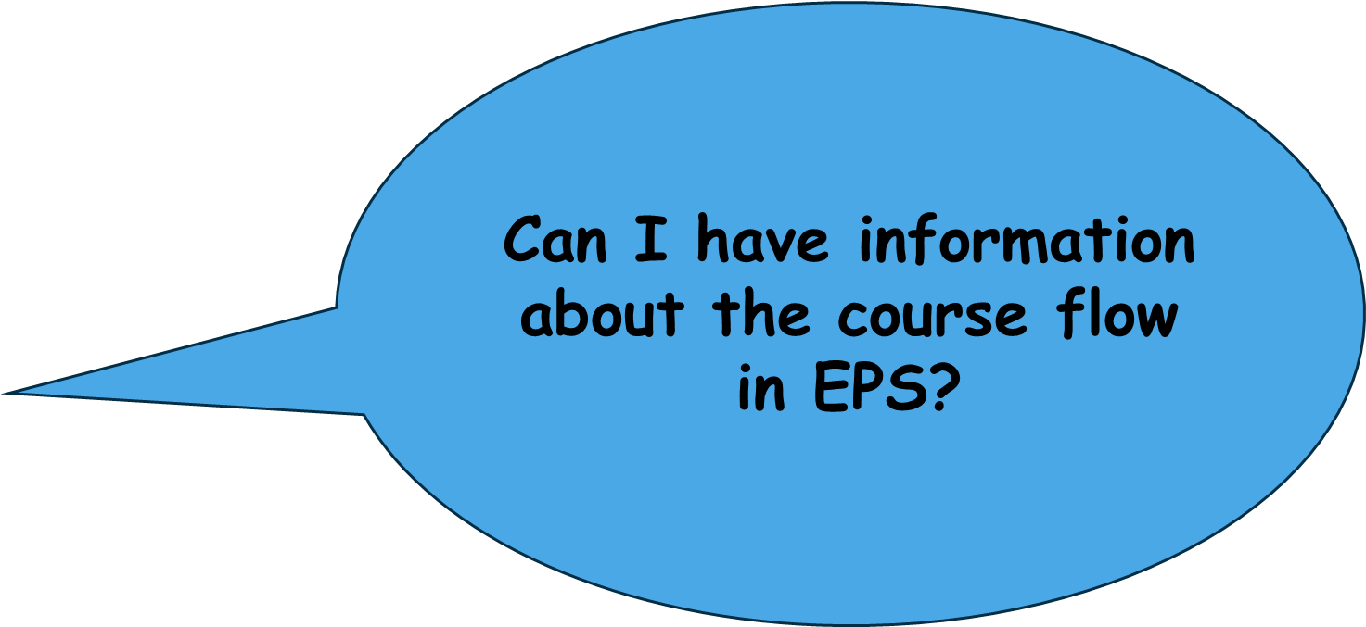


Slide 37
A student is required to complete successfully B1 level to take the Proficiency Exam.

Slide 38
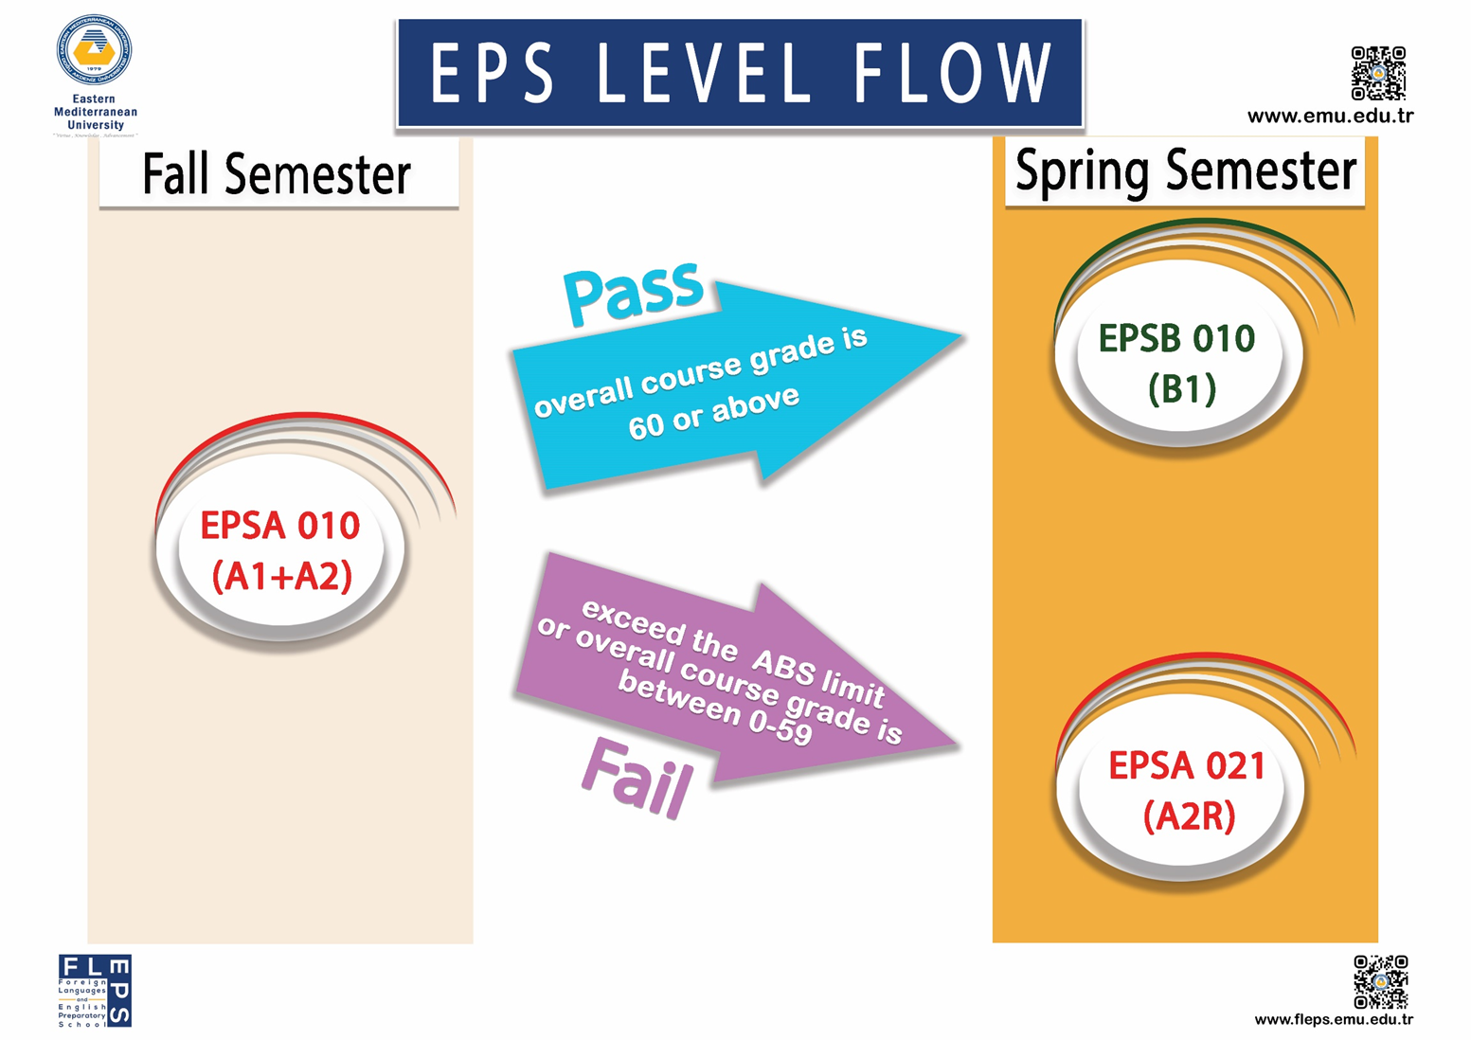

Slide 39


Slide 40
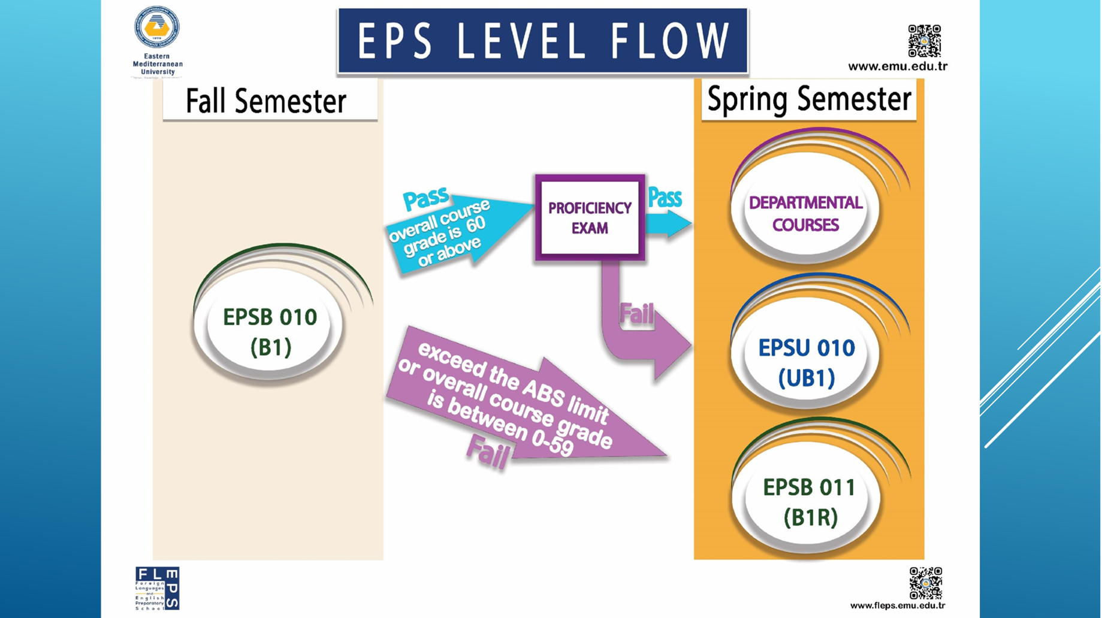

Slide 41
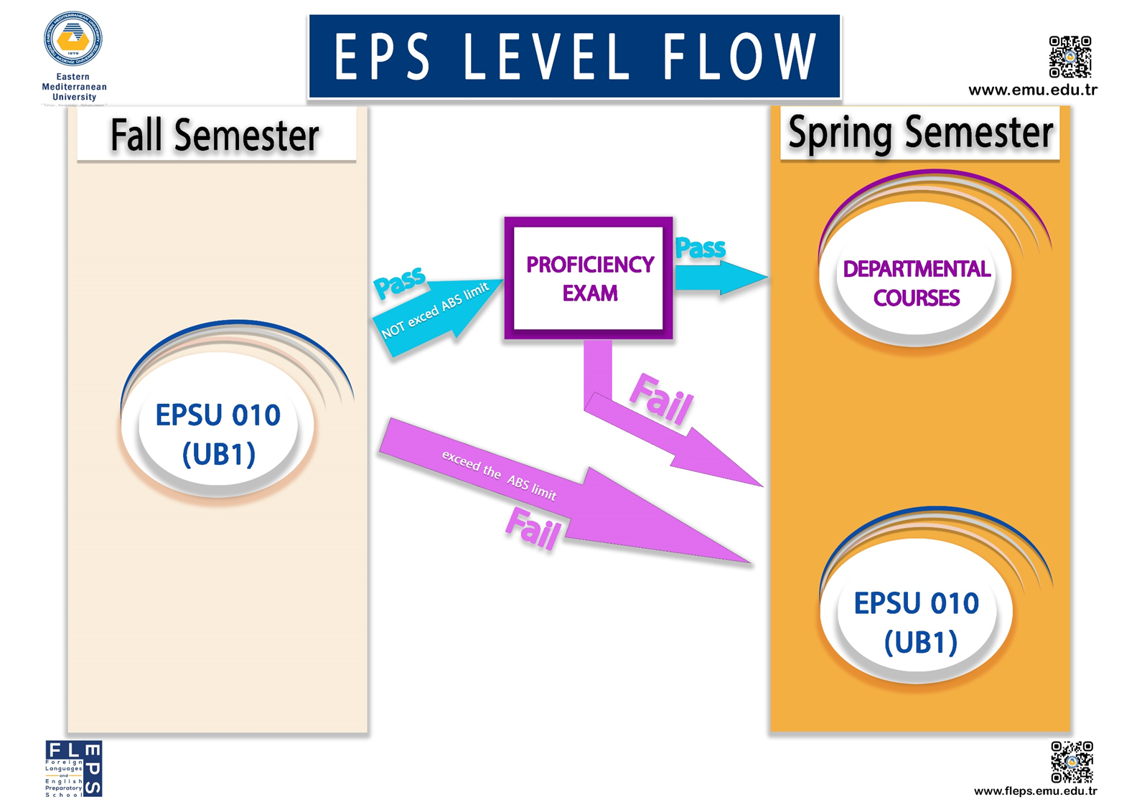

Slide 42
ASSESSMENT BREAKDOWN
Summative Assessment (80%) Progress Test: 20% Final Exam: 45% Online Tasks (Pearson-based): 5% for regular Listening and Language in use practice the best two grades out of 4 tasks will be taken into consideration Teacher Incentive: 5% Announced Reading & Language in Use Quizzes: 5% 3 quizzes, 2.5 pts each, best 2 count
Formative Assessment (20%) Paragraph Writing: 5% Paragraph: 8% Presentation: 5% Peer & Self-Assessment: 2%

Slide 43
COUNSELING CENTER
The Coordinator
Asst. Prof. Dr. Yonca AYBAY
Office No: 3E, 3rd Floor/ PREP 09, Ground Floor
Phone No: 0392 630 2261/ 0392 630 1296
E-mail: Yonca.aybay@emu.edu.tr

Slide 44


The Counselor can help students to understand how best they can learn and improve their academic performance by;
Examining individual blocks to efficient study,
Personal issue of motivation,
Time organization, and
Study management.

Slide 45
IF YOU FAIL B1 AT THE END OF THE YEAR,
You can complete B1 level in the summer school and take proficiency at the end of the course.
If you are not happy with your exam result after the summer school, you can take prof. again in September.
You can also take PTE exam which is internationally recognized.

Slide 46


Slide 47
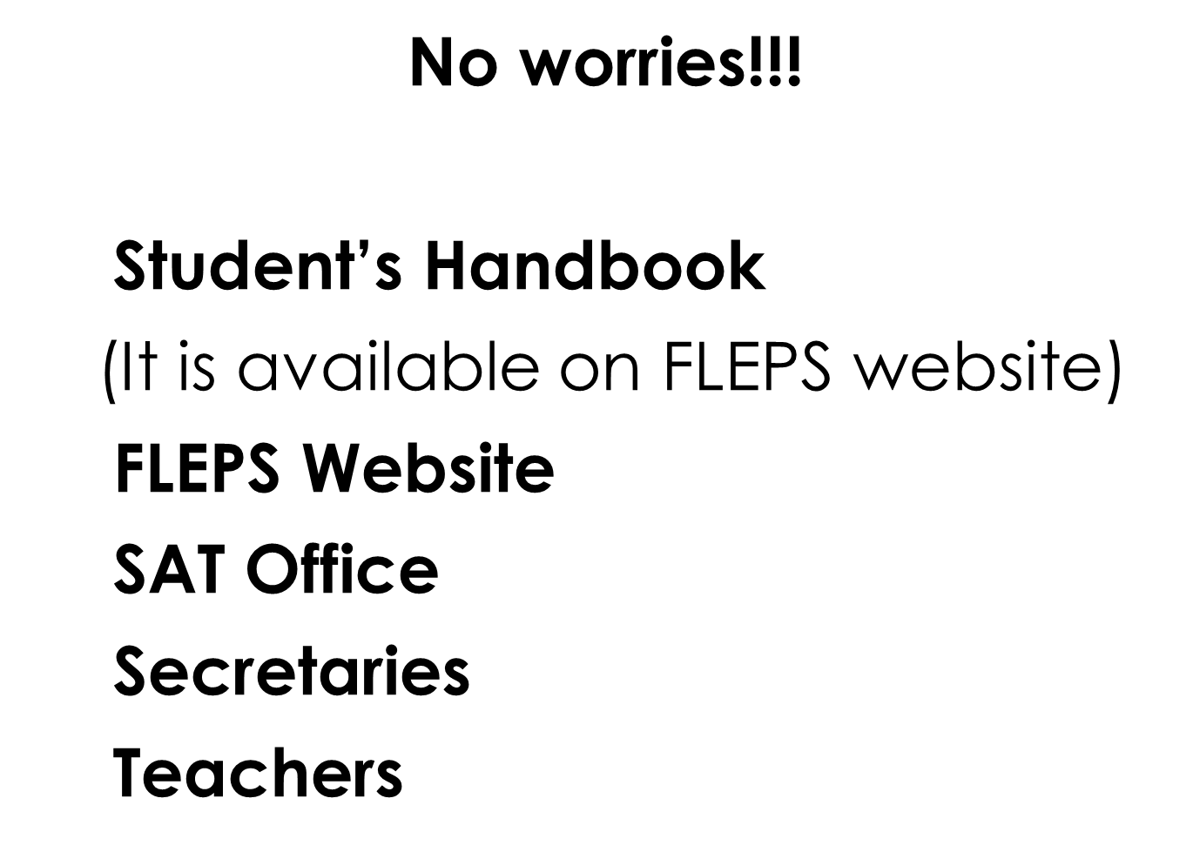

Slide 48
Good luck and welcome to EMU EPS
2025-2026

