Slide 1




EASTERN MEDITERRANEAN UNIVERSITY
ENGLISH PREPARATORY SCHOOL
ORIENTATION FOR EPS STUDENTS

Slide 2

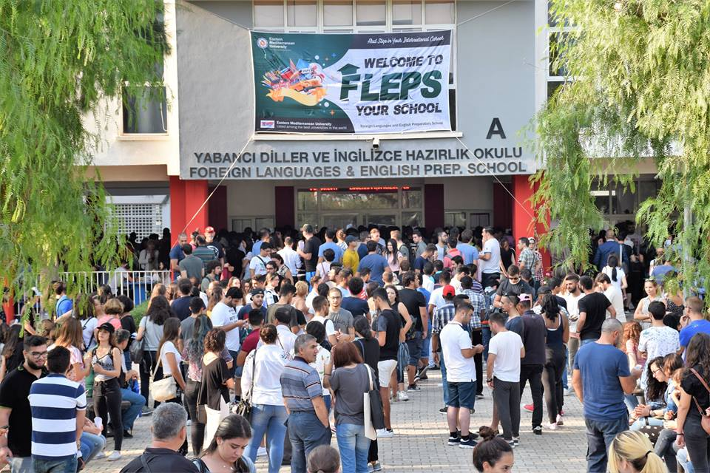


Welcome to FLEPS, your school

Slide 3
Who is who in this institution
The Director of FLEPS:
  Asst. Prof. Dr. Mutlu KALE
The Assistant Director of Student and Administrative Affairs:
  Senior Instructor Filiz KAVAZ

Slide 4
Who is who in this insitution
The Assistant Director of Turkish Program and International Exams Unit:
  Instructor Müsteyde Akhisar
The Assistant Director of Syllabus and Testing Unit
  Instructor Çelen Müezzin Karadağlı

Slide 5
HOW CAN I GET INFORMATION
STUDENT AFFAIRS TEAM (SAT)
Office no:224, 2nd Floor
Phone no:0392 630 1112
Contact: https://fleps.emu.edu.tr

Slide 6
HOW CAN I GET INFORMATION
SAT COORDINATOR : Heves SORGUÇ
RESEARCH ASSISTANTS:
Neepa NAROTTAM LODHIA
Aslıgül ASKIN/Omer Fidaner
ASSISTANT:
SELAY KESEN

Slide 7
HOW CAN I GET INFORMATION
Student Affairs Secretary
Office no: 223, 2nd Floor
Phone no: 0392 630 2153
Pembe KARA
FLEPS Secretary
(office 212, 2nd Floor)
Phone no: 0392 630 1330
Emine CANNUR
Administrator
Office no: 210, 2nd Floor
Phone no: 0392 630 2188
Ercan ERCANLAR
Computer Operator
Office no: 1E, 1st Floor
Phone no: 0392 630 2346
Whatsapp No:05338711075
Seyyed Ali Kamalı MOHAMAREH

Slide 8
EXTRA CURRICULAR ACTIVITIES (ECA)
TEAM LEADER: Zekiye DELLALOĞLU
TEAM MEMBERS: Sultan TAŞKIRAN
Fezile TOKER
Munise KEŞANLI
Ayşe ONUT
Refika İLKAN
Fayka GURESUN

Slide 9


Some Activities for This Semester
SPEAKING CLUB
ACADEMIC SUPPORT

Slide 10
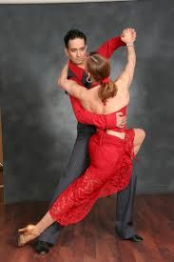

Salsa/ Bachata Dance Lessons
Grab Your Instrument

Slide 11


Nature Yoga
Upcycling

Slide 12
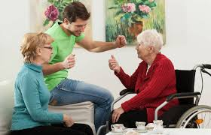
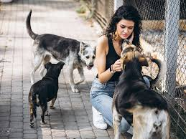
Elderly Home and Animal Shelter Visit

Slide 13
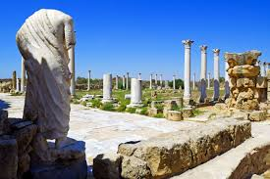
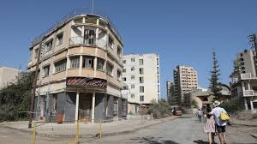
TRIPS
To Salamis Ruins
To Kapalı Maraş

Slide 14
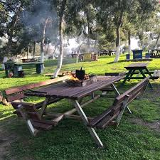
PICNIC

Slide 15


COMPETITIONS
QUIZ MONSTER
GRADED READER

Slide 16


SEMINARS
Effective ways of Studying
Exam Anxiety

Slide 17


Methods of Coping With Stress
Psychological Health

Slide 18
ECA Member Responsible for the Promotion and Social Media Unit
Fezile TOKER
Students can share their pictures online through the school instagram account
( emu_fleps_official )

Slide 19
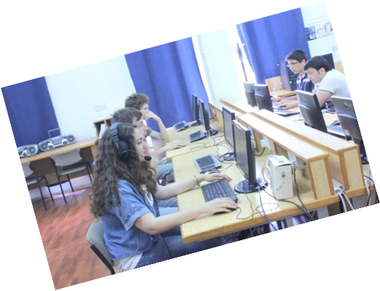
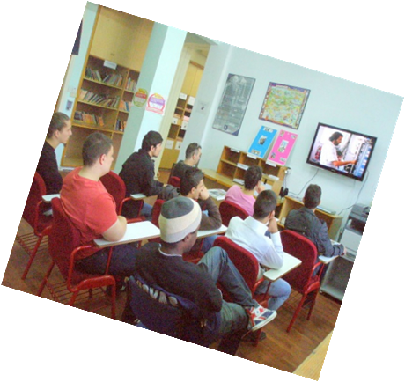
STUDENT SELF STUDY CENTER (SSSC)

Slide 20
What is the SSSC? How will it help me?
The SSSC is for YOU and will help you:
Improve and develop your English!
Introduce you to a WIDE range of resources
Help you learn better
Develop exam techniques
Practice what you have learnt in class- alone or with your friends & teachers
Offer you a comfortable environment when studying
Play chess with your friends.

Slide 21
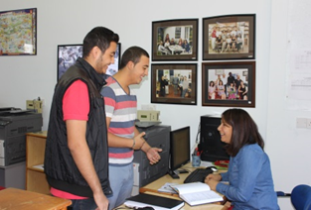
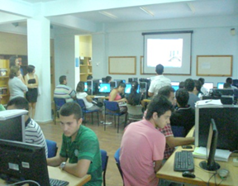
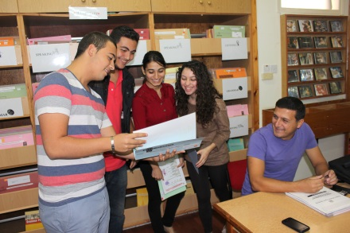
Our SSSC Areas
There are 3 different areas of the Study Center:
The Consultancy Area
The Multimedia (Computer) Area
3. The Self-Study Area

Slide 22
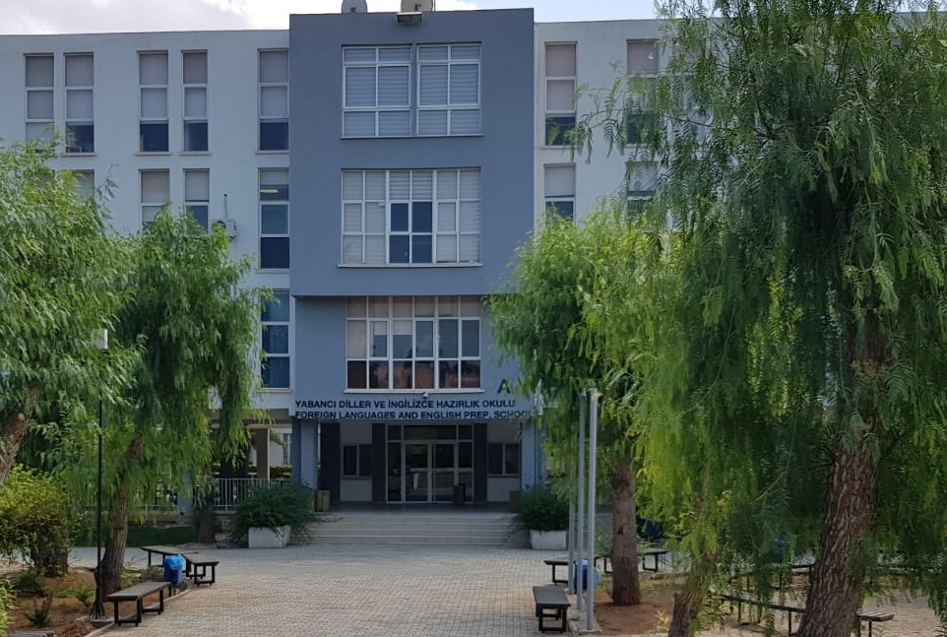
Did you know that Foreign Languages and English Preparatory School (FLEPS) is internationally accredited for quality education by Pearson Assured, DEDAK and EAQUALS?

Slide 23

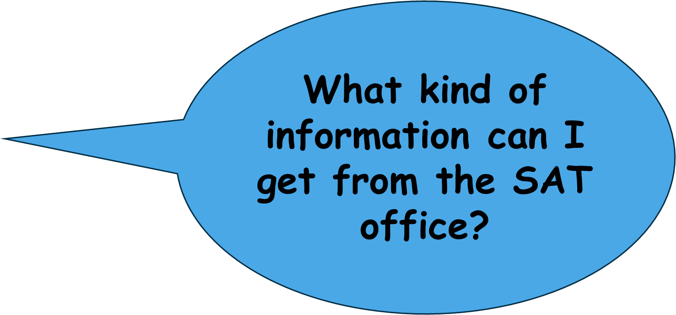

Slide 24
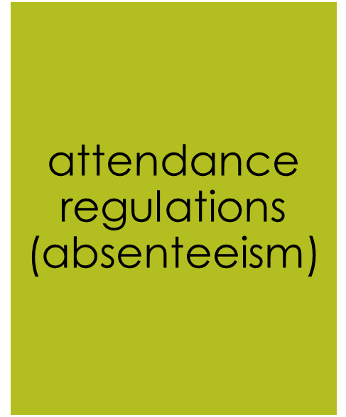

You can ask any questions about EPS.
For example;

Slide 25



Slide 26






You can send a petition for any reasons on our website (https://fleps.emu.edu.tr/en).
For example;

Slide 27
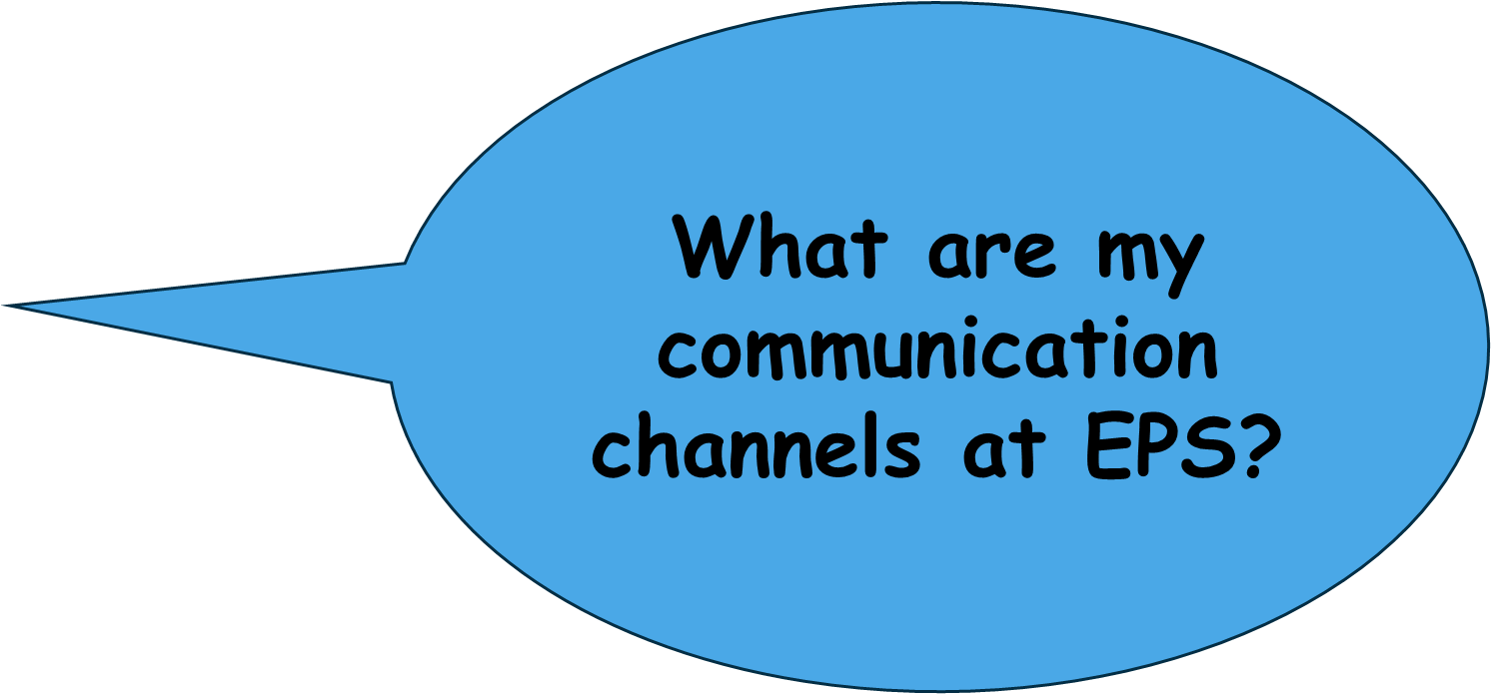

Slide 28
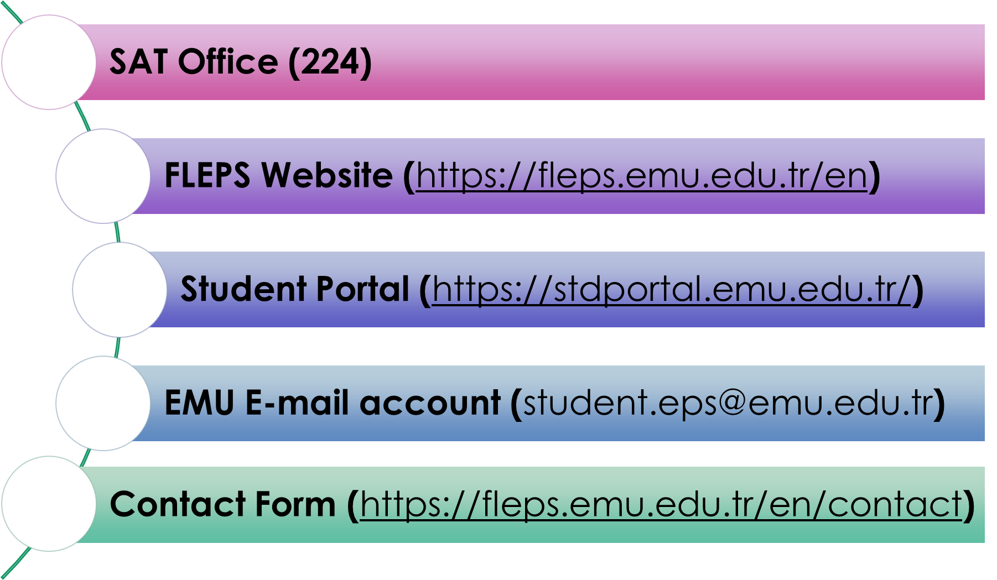
Class Representatives

Slide 29

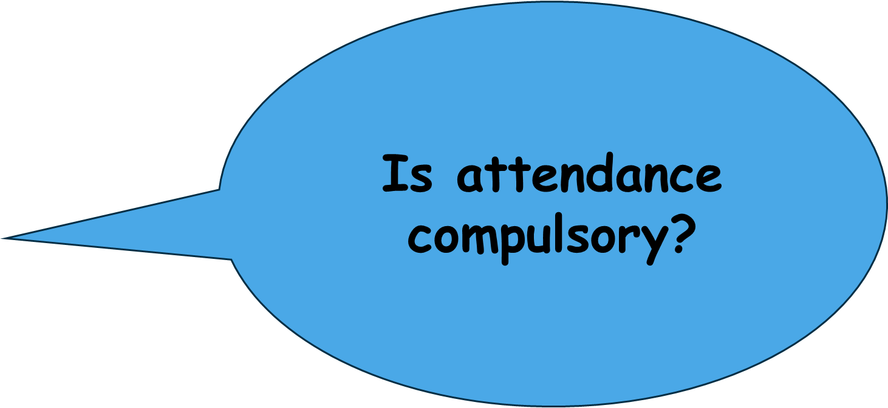

Slide 30

Attendance limit for A1/A2/B1:62 hours
For UB1:52 hours

Slide 31
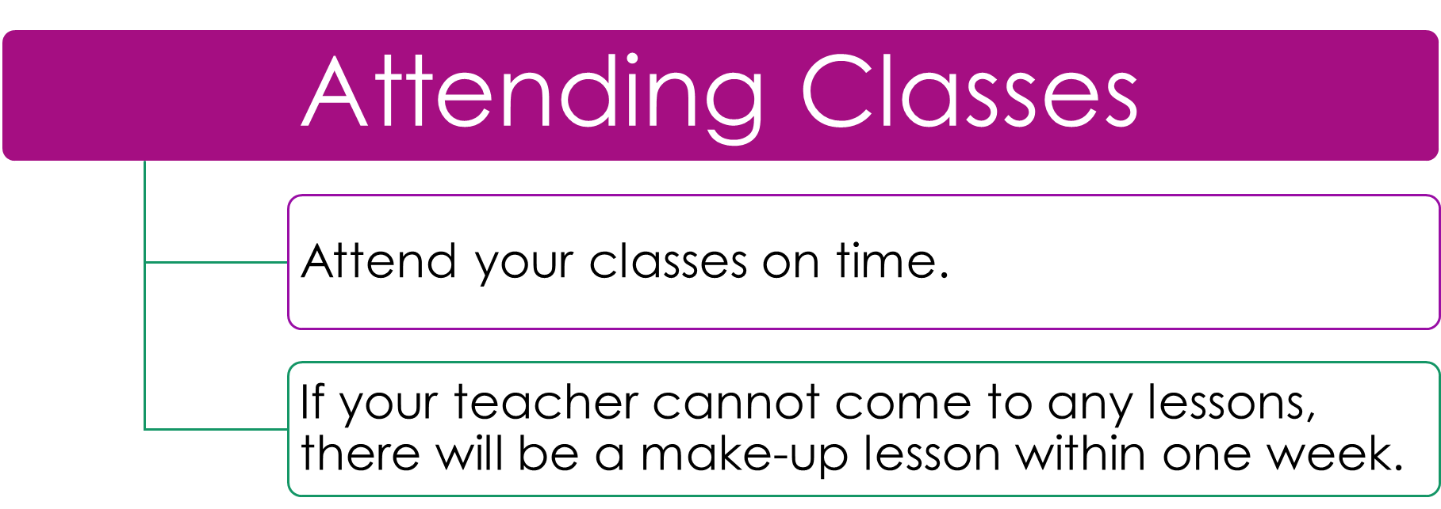

Slide 32
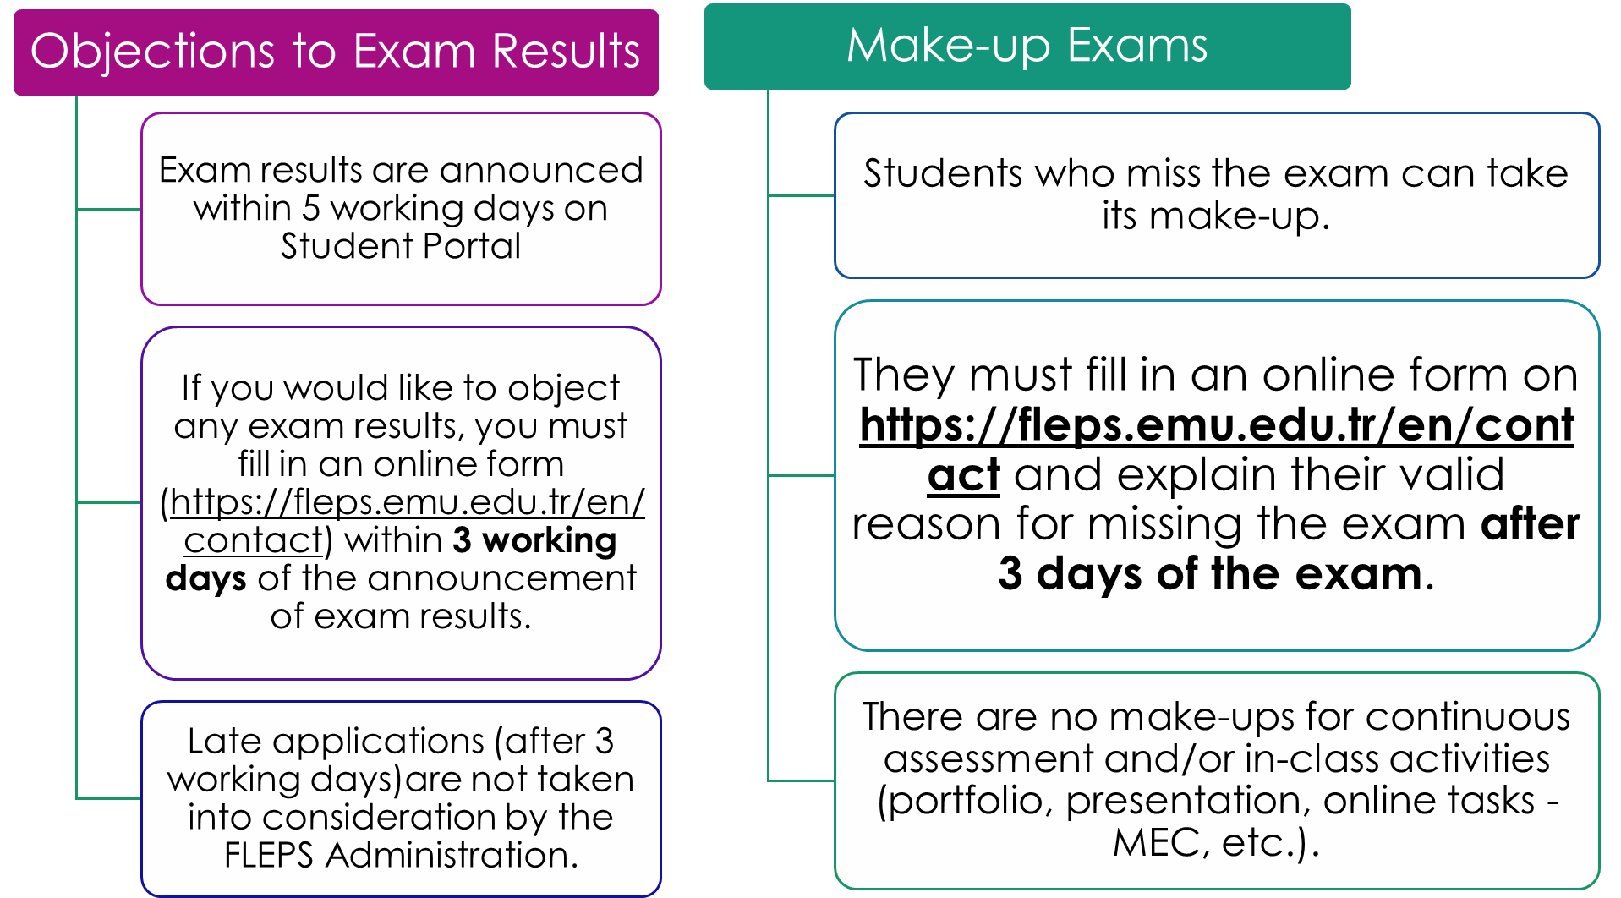

Slide 33
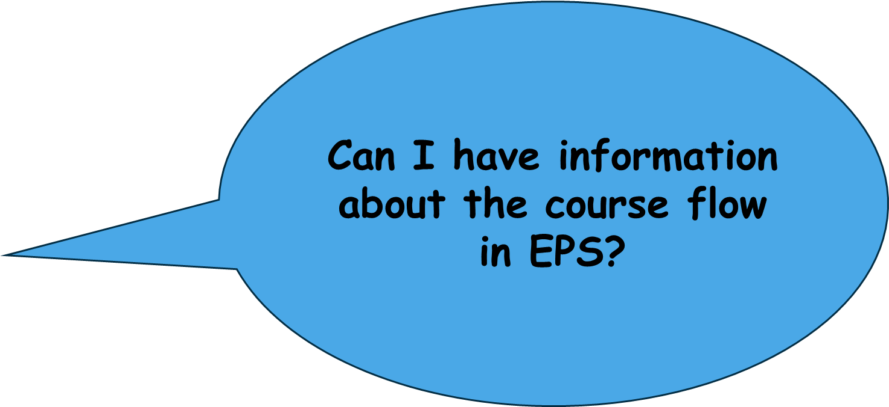


Slide 34
A student is required to complete successfully B1 level to take the Proficiency Exam.

Slide 35
EPS LEVEL FlOW
EPSA 010
EPSA 010 (EXCEED THE ABSENTEEISM LIMIT) EPSA020
EPSA010 FAIL (BELOW 60) EPSA020
EPSA010 PASS (ABOVE 60) EPSB010

Slide 36
EPS LEVEL FlOW
EPSA 020
EPSA 020 (EXCEED THE ABSENTEEISM LIMIT) EPSA020
EPSA020 FAIL (BELOW 60) EPSA020
EPSA020 PASS (ABOVE 60) EPSB010

Slide 37
EPS LEVEL FlOW
EPSB 010
EPSB 010 (EXCEED THE ABSENTEEISM LIMIT) EPSB010
EPSB010 FAIL (BELOW 60) EPSB010
EPSB010 PASS (ABOVE 60) PROF. EXAM
PROF. EXAM (FAIL) EPSU010 (UB1)

Slide 38
EPS LEVEL FlOW
EPSU 010 (UB1)
EPSU 010 (EXCEED THE ABSENTEEISM LIMIT) PROF. EXAM (NO BONUS)
EPSU 010 (SITTING ALL THE EXAMS) PROF. EXAM (WITH BONUS/ 20%)
PROF. EXAM (FAIL) EPSU010 (UB1)

Slide 39
EPS Assessment Overview for All Levels
A1 • A2 • B1–B1+ • UB1
Assessment component | A1 | A2 | B1 | UB1
Summative assessment total | 75% | 75% | 75% | 65%
Progress Test | 20% | 20% | 20% | 12%
Final Exam | 45% | 45% | 45% | 48%
Teacher Incentive | 5% | 5% | 5% | 5%
Reading and Language in Use Quizzes | 5% | 5% | 5% | —

Slide 40
Formative assessment total | 25% | 25% | 25% | 35%
Paragraph Writing Quiz 1 | 5% | 5% | 5% | —
Paragraph Writing Quiz 2 | 8% | — | — | —
Editing of Paragraph Writing Quiz 2 | 2% | — | — | —
Essay Writing Quiz | — | — | 10% | —
CIP Post Task Review | — | 8% | — | —
Presentation or Presentation 1 | 8% | 4% | 8% | —
Peer and Self Assessment or P1 | 2% | 1% | 2% | —
Presentation 2 CIP | — | 5% | — | —
Peer and Self Assessment P2 | — | 2% | — | —
Writing Assignment 1 | — | — | — | 7.5%
Writing Assignment 2 | — | — | — | 7.5%
Departmental Project 1 | — | — | — | 10%
Departmental Project 2 | — | — | — | 10%
Total excluding bonus | 100% | 100% | 100% | 100%
Efekta bonus additional to course total | Up to 5% | Up to 5% | Up to 5% | Up to 5%

Slide 41
UB1 proficiency contribution: 20% of the total EPSU010 course grade is added to the proficiency grade. Students must meet the 80% attendance requirement to take the final exam and receive the bonus points.
For A1, A2 and B1, three Reading and Language in Use quizzes are administered; the best two scores count, each contributing 2.5 percentage points.
Efekta provides a bonus of up to 5 points for all four levels, additional to the 100% course total.

Slide 42
COUNSELING CENTER
The Coordinator
Asst. Prof. Dr. Yonca AYBAY
Office No: 3E, 3rd Floor/ PREP 09, Ground Floor
Phone No: 0392 630 2261/ 0392 630 1296
E-mail: Yonca.aybay@emu.edu.tr

Slide 43


The Counselor can help students to understand how best they can learn and improve their academic performance by;
Examining individual blocks to efficient study,
Personal issue of motivation,
Time organization, and
Study management.

Slide 44
IF YOU FAIL B1 AT THE END OF THE YEAR,
If you are not happy with your exam result after the summer school, you can take prof. again in September.
You can also take any internationally recognised exams such as PTE;IELTS;TOEFL ibt etc.

Slide 45


Slide 46
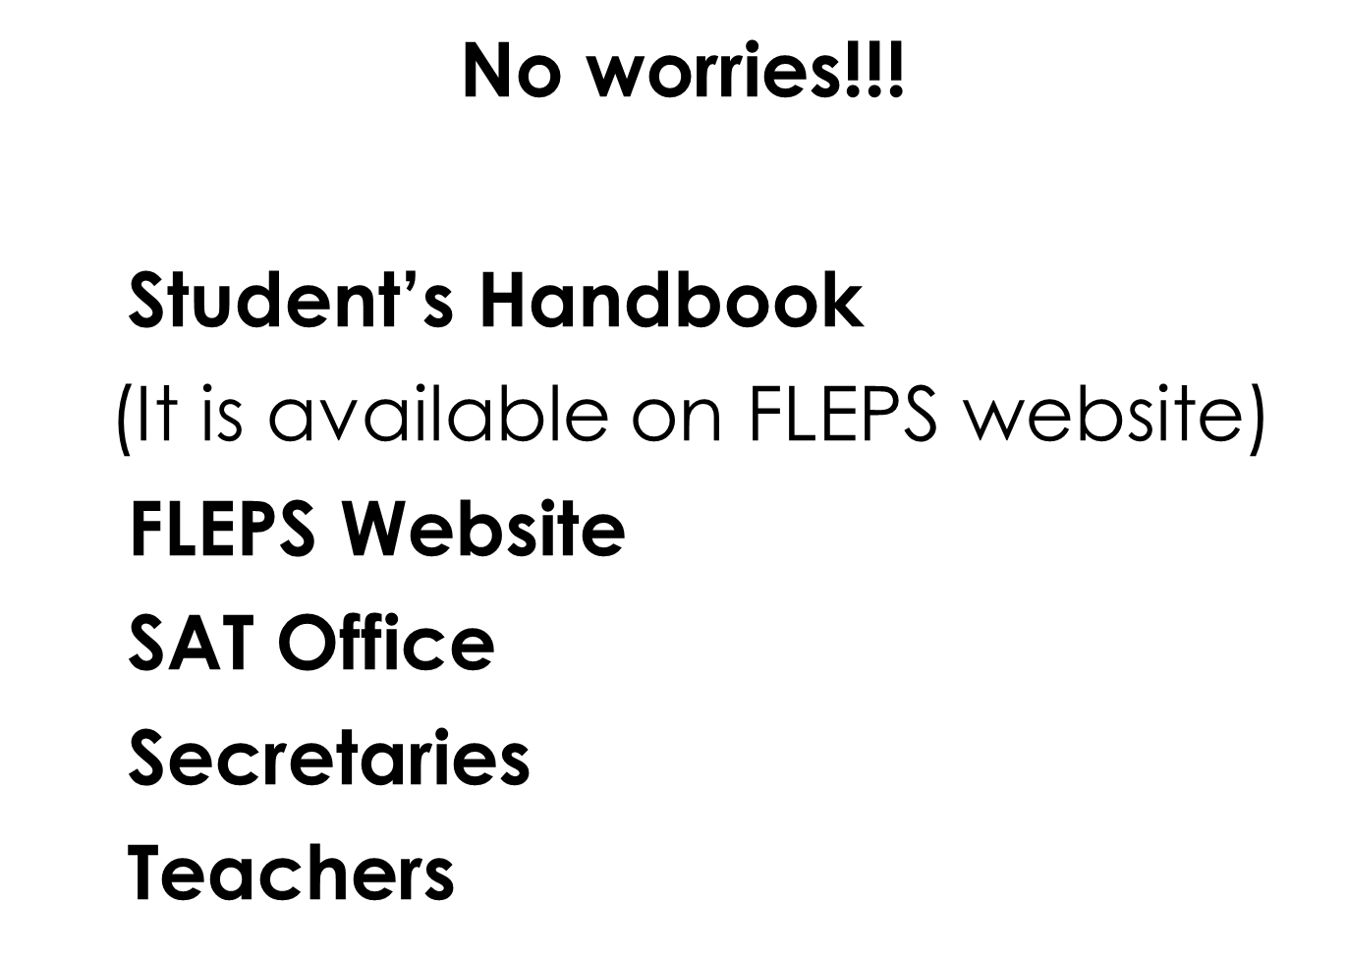

Slide 47
Good luck and welcome to EMU EPS
2026-2027

